Slide 1
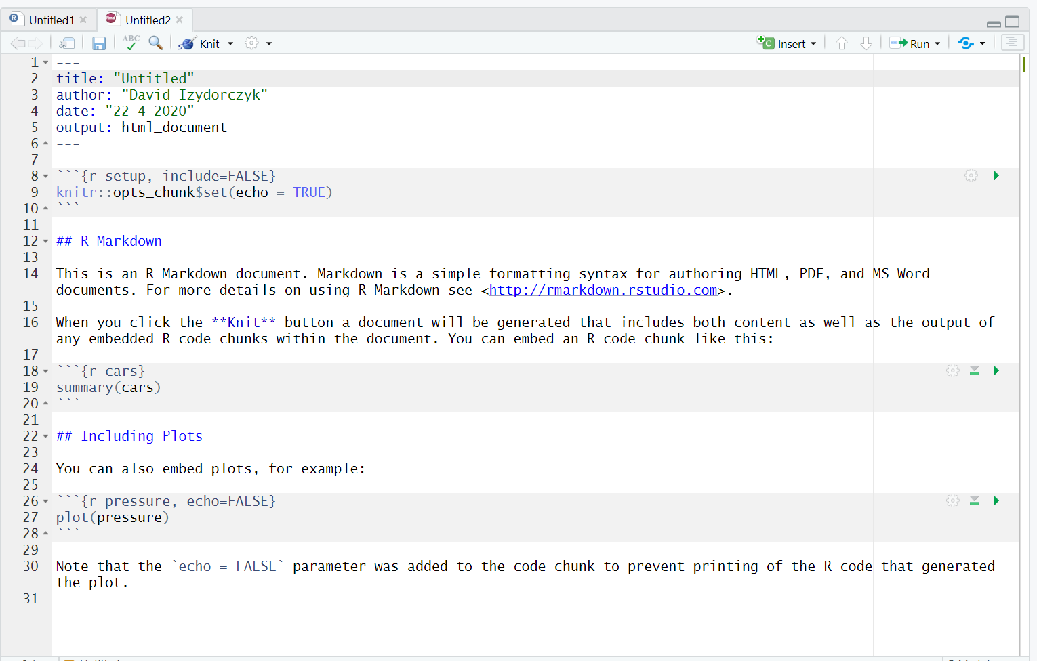
YAML Header
Setup Chunk
Text
Code Chunk
Inline Code

